Slide 1


Job
Analytics

Slide 2

Agenda
1 | Introduction
2 | Problem Statement
3 | Objective
4 | Roadmap
5 | Tools and Technologies
6 | Dataset
7 | Data Preview
8 | Analysis
9 | Future Scope
10 | Conclusion

Slide 3
Introduction
In today's job market, job seekers and employers face numerous challenges when it comes to finding the right fit.
The rise of online job search platforms has made it easier to connect job seekers and employers, but with so many job postings and resumes available online, it can be overwhelming to sift through the data and find the best match.
This is where job analytics comes in, providing tools to help both job seekers and employers make more informed decisions.
In this project, we have used job analytics to analyze job postings from the Instahyre website, with the aim of gaining insights into the job market for data science and analytics roles in India.

Slide 4

Problem Statement
With the growing number of job opportunities available on the internet, it can be challenging for job seekers to find relevant job postings that match their skills and interests. As a result, it becomes difficult for companies to find suitable candidates for their job openings.

Slide 5

Objective
Analyze the job market and provide insights to
both job seekers and employers.

Slide 6

Roadmap
Collect job data from Instahyre, a popular job portal in India.
Analyze the job data to identify the top job roles and skills in demand
Visualize the job data using various data visualization techniques to provide job seekers with a comprehensive view of the job market
Provide insights into the job market to help job seekers make informed decisions about their career paths

Slide 7


Tools and Technologies
We utilized a variety of technologies to collect, clean, and analyze our data.
Selenium: Used for collecting data by web scraping.
Pandas: Used for data cleaning and preprocessing.
SQL: Used for database management.
Excel: Used for data manipulation, data visualization and Dashboard.

Slide 8

Dataset
The dataset comprises two tables: Job Details and Company Details.
Job Details contains 3944 records and Company Details contains 1432 records.
The data was collected through web scraping job postings from Instahyre, a job portal platform.

Slide 9
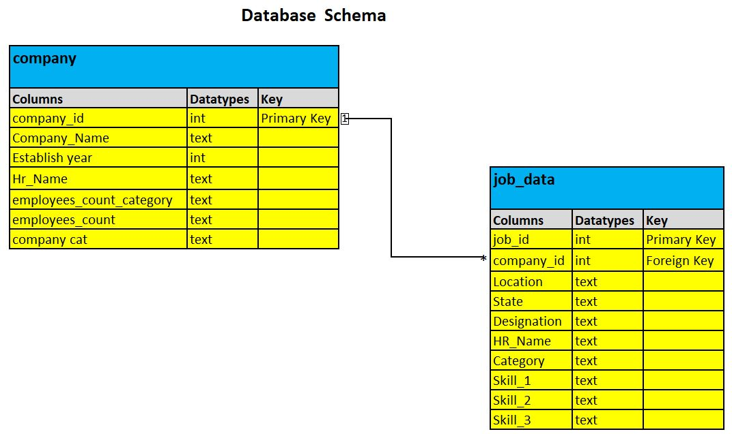

Slide 10
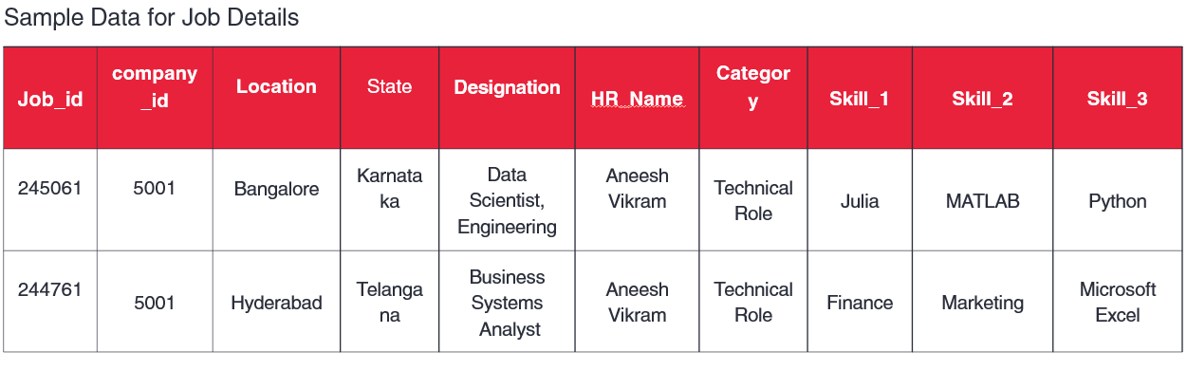
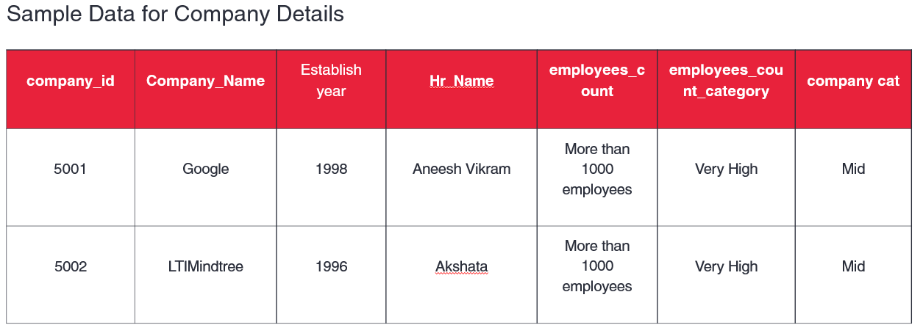
Data Preview

Slide 11
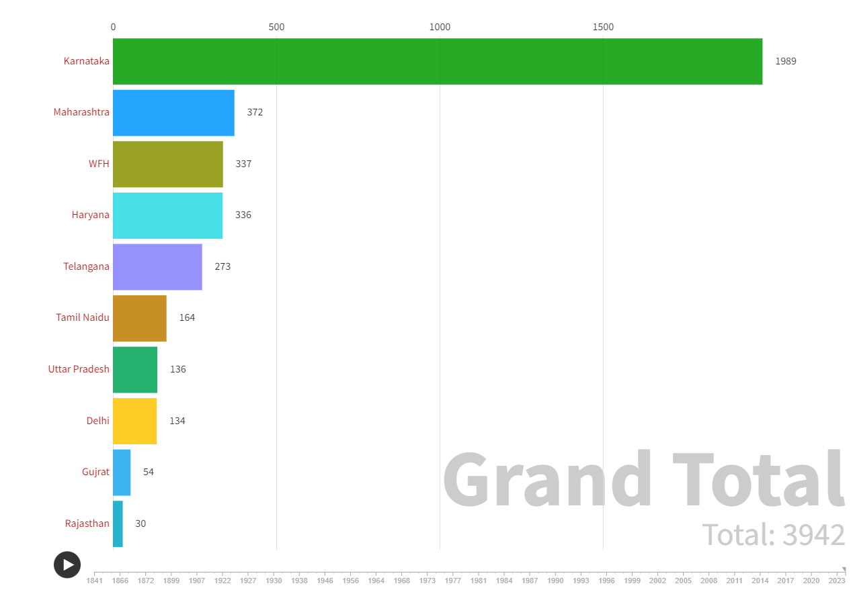
Analysis
Regional differences between top 10 states
Karnataka, Maharashtra, and Haryana are the top three states with the highest number of job vacancies.
Karnataka has the highest number of job vacancies in the private sector, with 1989 vacancies. This could be because Karnataka is home to many IT and technology companies, and hence has a high demand for skilled professionals in these sectors.
It's important to note that these numbers only represent the job vacancies posted in the specific source that provided the data, and may not represent the entire job market in each state/territory. Additionally, the number of job vacancies may change over time and may vary across different industries and job roles.

Slide 12
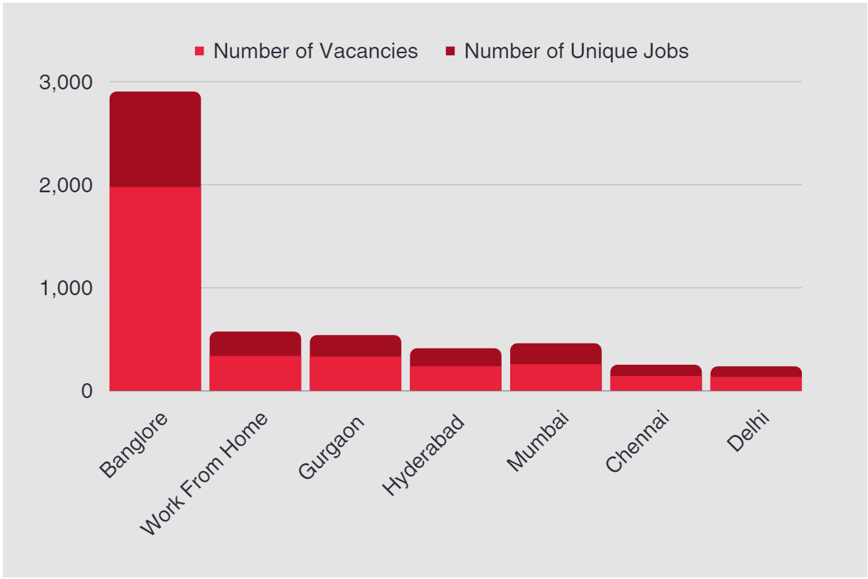
Hiring Hotspot
The highest number of vacancies are in Bangalore, followed by Work From Home and Gurgaon. This could indicate that these cities are major hubs for job opportunities in the industry.
While Mumbai has a high number of unique jobs, it has a comparatively lower number of vacancies. This could suggest that the competition for jobs in Mumbai is relatively high.
Chennai and Delhi have the lowest number of vacancies and unique jobs among the cities listed. This could indicate that the job market in these cities is not as robust as in the other cities.

Slide 13
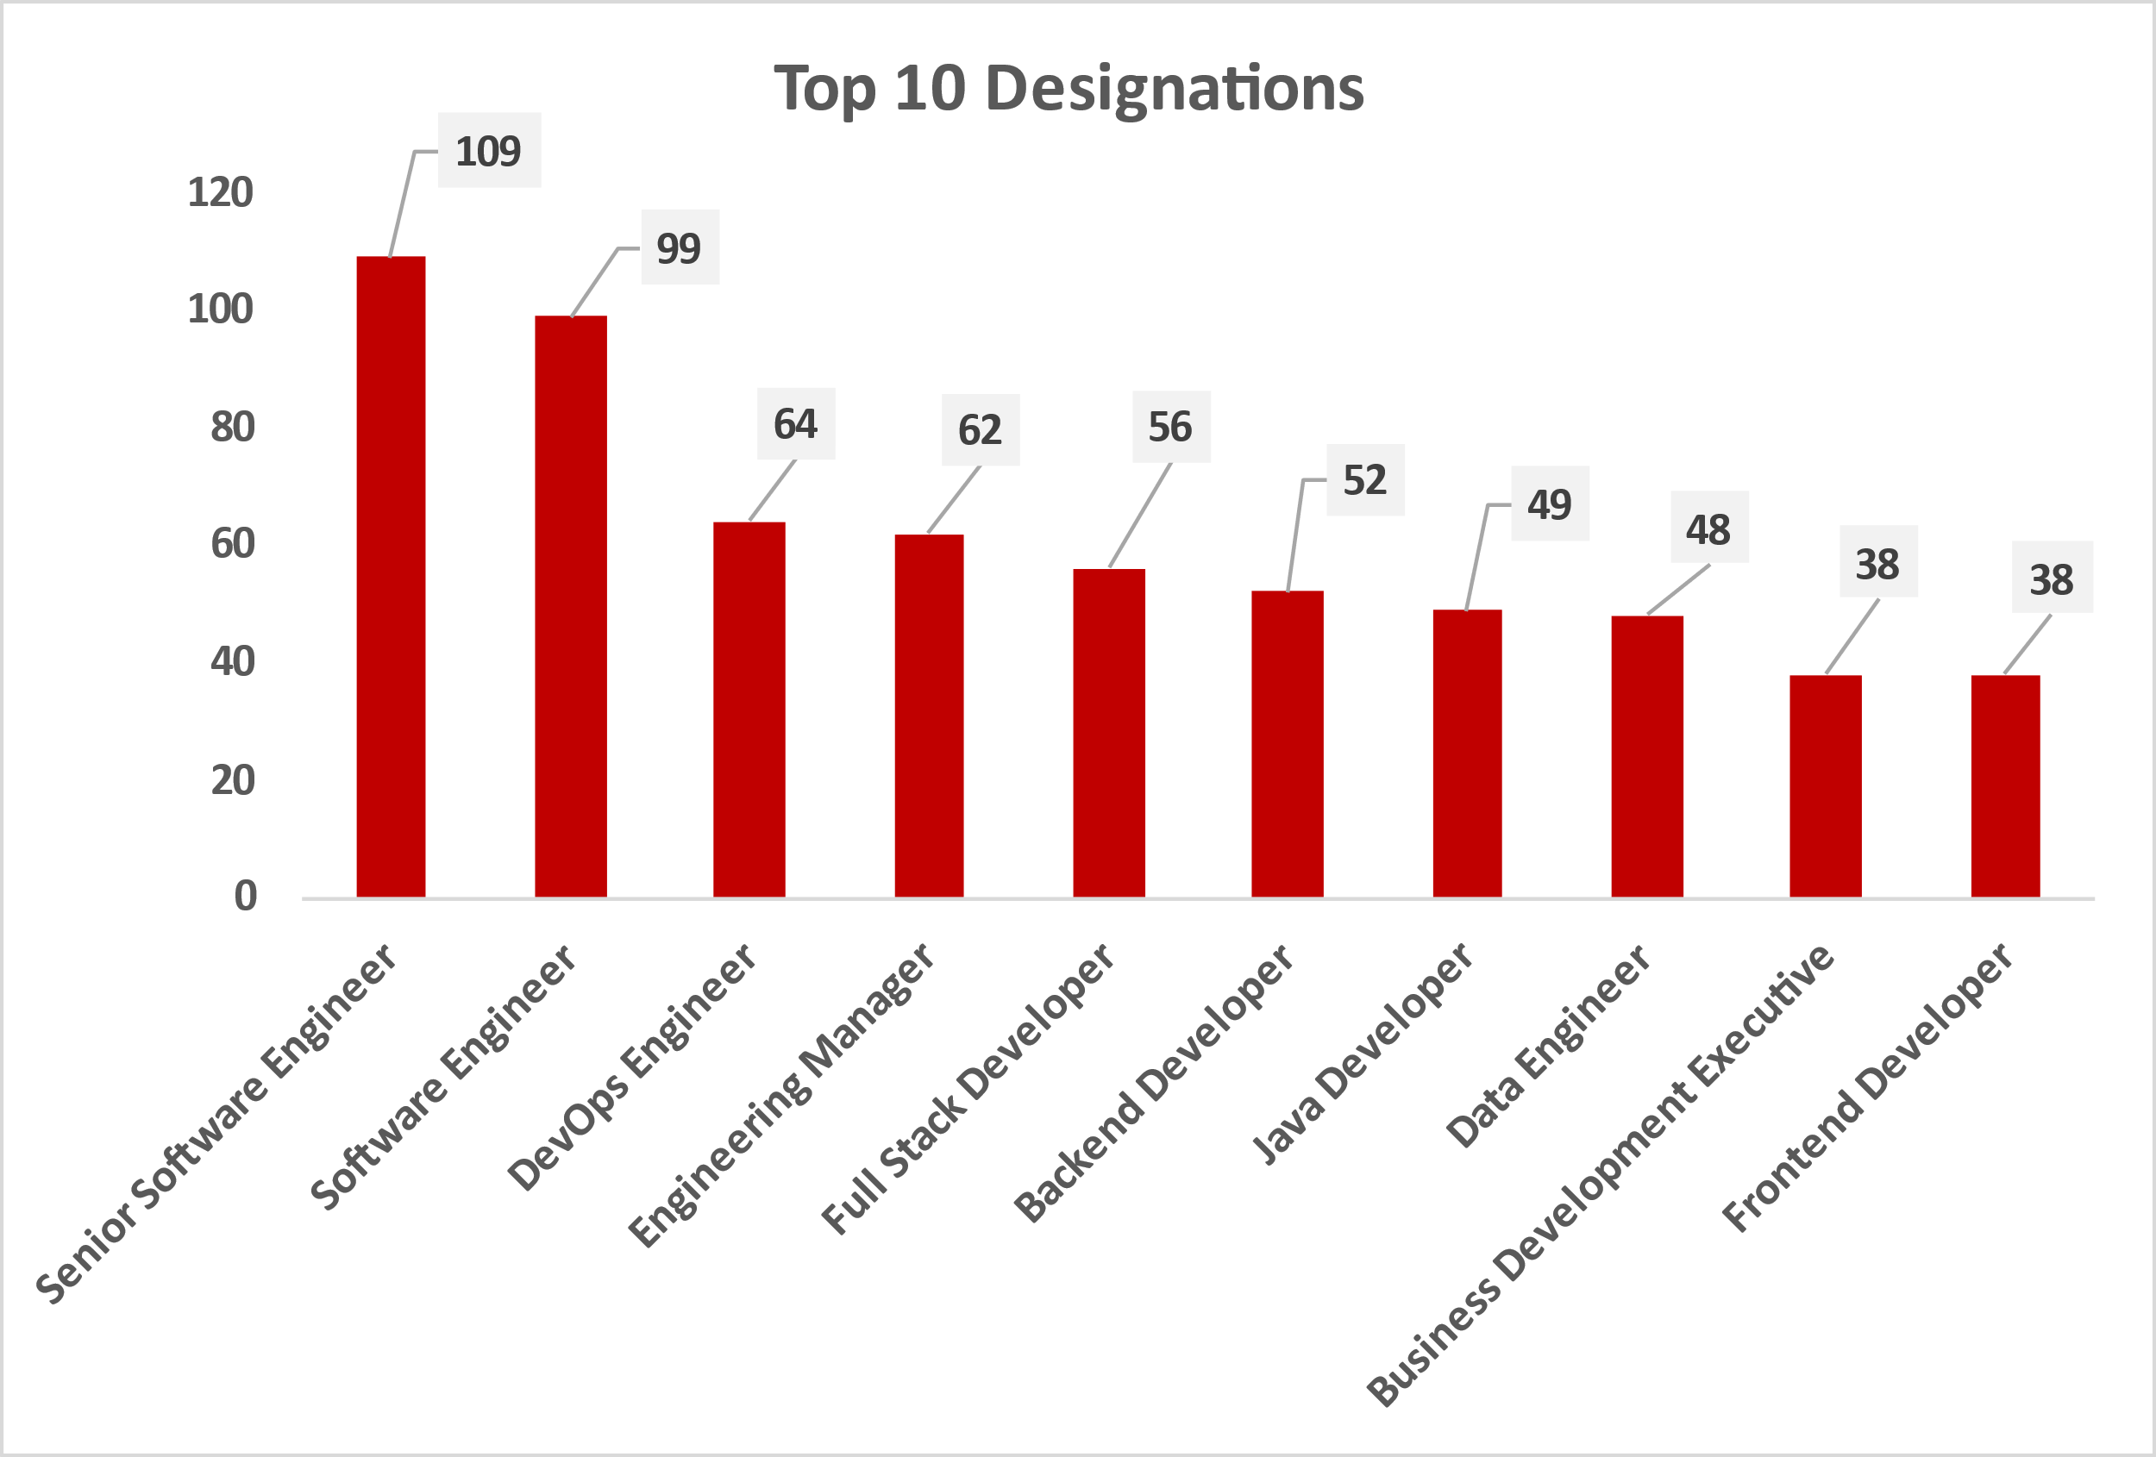
Exploring Job Trends in India
Senior Software Engineer, Software Engineer, and DevOps Engineer were the top 3 most common job titles posted on Instahyre, with 110, 99, and 64 job postings, respectively.
The high number of postings for experienced software developers and engineers suggests a strong demand for these skills in the industry.
The significant number of job postings for Data Engineer indicates a growing need for data-related skills in the industry.
These insights provide valuable information for job seekers and employers looking to better understand the current job market in the tech industry in India.

Slide 14
Industry Distribution in Job Market
The majority of job openings in this job market snapshot are in startup companies, with 52% of the total job vacancies. This suggests that there may be more opportunities available for individuals interested in working in a startup environment.
The recent job vacancies make up the second-highest percentage at 32.8%. This could indicate that companies are focused on hiring individuals with more recent experience and skills that are relevant to the current industry trends.
Early : 1841 – 1950
Mid : 1951 – 1999
Recent : 2000 – 2014
Start-up : 2015 – 2023
Early
3%
Mid
12.2%
Start-up
52%
Recent
32.8%

Slide 15
Location-wise Demand for Frontend Engineers and Data Analysts
Bangalore has the highest job opportunities in both Frontend Engineering and Data Analyst roles, with a significant difference in the number of job openings between the two roles.
Hyderabad has a considerable number of Data Analyst jobs, compared to the Frontend Engineer.
The increasing demand for data analysis skills in the tech industry is evident from the significantly higher number of job vacancies for data analysts across multiple locations.
Location | Frontend Engineer | Data Analyst
Bangalore | 8 | 17
Hyderabad | 2 | 4
Pune | 1 | 2
Total | 11 | 23

Slide 16
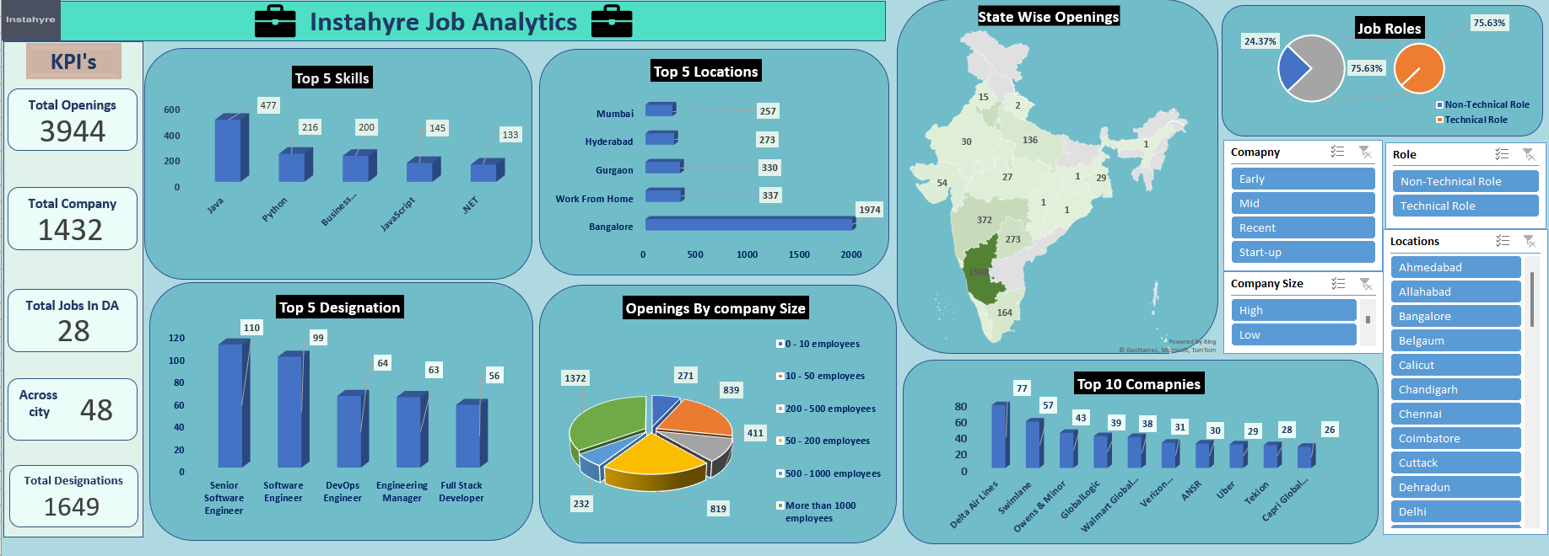
Dashboard
Dashboard.xlsx

Slide 17

Future Scope
Based on the insights and trends observed in the job market data, it can be inferred that there is a growing demand for data analysts and other tech professionals with data analysis skills.
This trend is likely to continue in the future as businesses increasingly rely on data-driven decision making.
The demand for tech talent is expected to increase as more companies continue to digitize their operations and expand their online presence.

Slide 18
Conclusion
This project aimed to extract job postings data from Instahyre, clean and analyze the data, and provide insights into the job market.
The use of Python libraries such as Selenium, Pandas, and Matplotlib facilitated the extraction, cleaning, and visualization of the data, and the SQL database helped in organizing and managing the data.
The insights derived from the analysis provided valuable information for job seekers and employers, including the most in-demand skills, top industries hiring, and popular job titles.
Overall, this project demonstrated the importance of data analysis in providing insights and solutions to real-world problems and highlighted the potential of Job Market and data visualization tools in the job market analysis.

Slide 19


